Slide 1
Political Repression in Tunisia
The case of Fahem Boukadous
Presentation to the Middle East Discussion Group
By R. Prince – Lecturer/Korbel School of International Studies - Denver

Slide 2
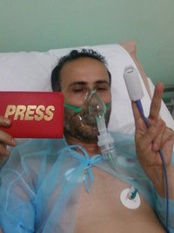
Farem Boukadous: Tunisian Political Prisoner
Fahem Boukadous hospitalized just before his arrest and imprisonment. He suffers from a bad case of asthma, made only worse by his incarceration

Slide 3
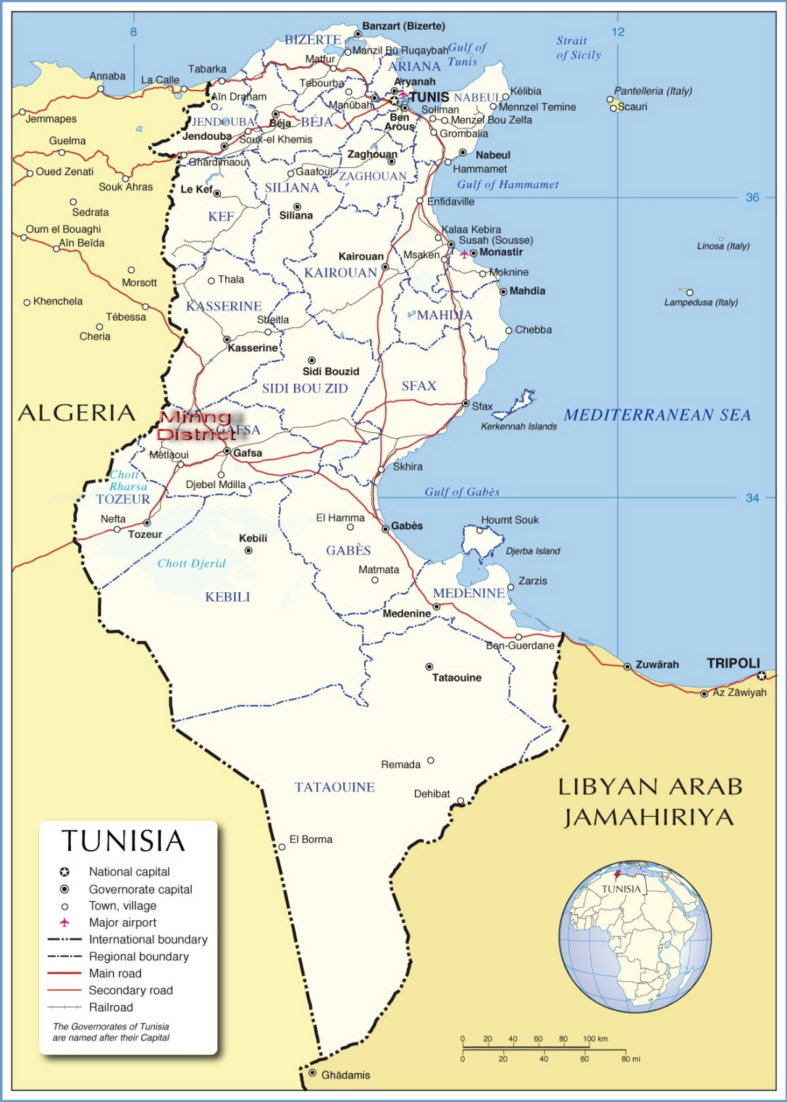
Map of Tunisia with Phosphate mining district hi-lited in red

Slide 4
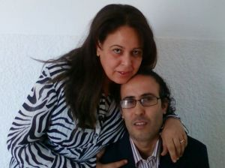
Tunisia – General Remarks
General Remarks
Colonial Period
Independence
Economy – no oil
Bourguiba – Ben Ali – 54 years of independence two presidents
Fahem Boukadous and his wife and companera,
Afef Ben Naceur

Slide 5
Repression in Tunisia - History
History of Repression in Tunisia
Bourguiba practiced it – pitting one group against another (secular leftists against Islamic movement early on, and then the opposite – using the Islamic movement against the secular left)…but it tended to be somewhat selective
Since Zine Ben Ali came to power in 1987, the repression has been much more generalized, one might even say rampant.
Many reports of this in Amnesty International and Human Rights Watch over the years

Slide 6
Repression in Tunisia History 2
The Repression in Tunisia has been occasionally acknowledged by the US State Department – including the Boukadous case…
But any serious action on this front has long been ignored. U.S. strategic regional concerns trump human rights concerns
Human rights violations of U.S. allies like Tunisia, Egypt, Saudia Arabia, Israel are either downplayed…or ignored
This is a double standard of long duration
Time for a change here: US influence in Tunisia is/could be considerable

Slide 7

The Boukadous Case: Shooting The messenger
Fahem Boukadous was a journalist for the satellite tv station El Hiwar El Tounsi
For six months in 2008 he covered a social protest movement in Tunisia’s phosphate mining district centered around the town of Redeyef, near the Algerian border

Slide 8
The Redeyef Social Movement
The Redeyef protests were a classic case of social dislocation caused by modernization
Over the past 25 years, Tunisia’s state owned mining industry has been significantly modernized
While the mining industry was made more efficient, employment in the mines dropped from 15,000-to-20,000 (the exact figures are hard to come by) to around 5000 with the lion’s share of the former miners thrown out of work
There are no other job opportunities in the region, or hardly so

Slide 9
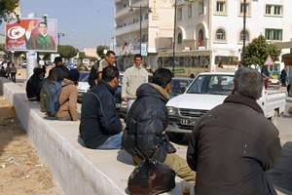
The Redeyef Social Movement 2
The main grievances of this protest movement were overwhelmingly economic (and some environmental)
They included:
- protesting the high levels of unemployment
- calling for medical benefits for the families of miners with job related injuries
- democratization of hiring practices
- environmental cleanup of mine-related pollution
Unemployed in Gafsa, at the heart of the phosphate mining district

Slide 10
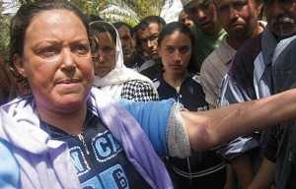
The Redeyef Social Movement 3
At the beginning of 2008, virtually the entire population of the Redeyef region `rose up’ in protest, demanding reforms
The women of the region – the mothers, daughters, wives played a key role
As did teachers at the local schools.

Slide 11
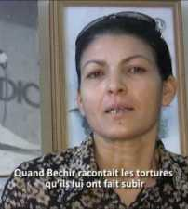
Leila Khalid – Wife of Bechir Labidi

Slide 12

The movement was crushed by the Ben Ali government
civilians – including non demonstrators – were fired upon by the military and state police
Hundreds were arrested; reports and evidence of torture were rampant
20 or so local leaders of the protest were given long prison sentences
Local educators – I am proud to say – played a prominent role

Slide 13
The Redeyef Social Movement 4
The Ben Ali government did all in its power to stop publication of the Redeyef events – hoping to achieve a media black out.
This effort failed
Meetings were held throughout Tunisia (and some in France) in which participants in the Redeyef events told their stories
The foreign press picked up the issue too, especially the French press, but also The Economist.
There was little notice of these events – despite their size and duration – in the USA

Slide 14
Boukadous’ `Crime’…Telling the Redeyef Story
Fahem Boukadous was one of the few Tunisian journalists who had the courage to go to Redeyef during the months of the protest movement and report on it, and in so doing angered the Ben Ali regime.
It is entirely as a result of his reporting that he was sentenced to four years in prison – both as a punishment for having exposed the situation in Redeyef, and as a warning to other Tunisian journalists who might try to do likewise

Slide 15
Free Fahem Boukadous
It is largely through efforts of Boukadous and journalists like him that the story of Redeyef has come to the attention of a world-wide audience…
The latest news is that Boukadous is now in the 23rd day of a hunger strike;
Let us do what we can to free Fahem Boukadous and all political prisoners in Tunisia

